Slide 1


MAULANA AZAD NATIONAL INSTITUTE OF TECHNOLOGY, BHOPAL, M.P., INDIA 462003
VIII SEMESTER EQUIVALENT RESEARCH INTERNSHIP AT COGNITIVE SPACE DESIGN SOLUTIONS LAB AT
UNIVERSITY OF BREMEN, GERMANY
(FEBRUARY 1, 2015 – JUNE 30, 2015)
INTERNAL ADVISOR: EXTERNAL ADVISOR:
Prof. SARITHA KHETHAWAT Dr. MEHUL BHATT
ASSISTANT PROFESSOR PROFESSOR AND CHIEF INVESTIGATOR
DEPARTMENT OF COMPUTER SCIENCE COGNITIVE SYSTEMS AND
AND ENGINEERING SPATIAL COGNITION RESEARCH CENTRE
M.A.N.I.T. BHOPAL, MP, INDIA UNIVERSITY OF BREMEN, GERMANY
BY:
HARSHITA JHAVAR
111112003, DEPARTMENT OF COMPUTER SCIENCE AND ENGINEERING,
M.A.N.I.T. BHOPAL, M.P., INDIA. (2011-2015)

Slide 2

“Are your experiments drowning in data?”
“What would your data tell you if it had a voice?”
“How would your world change if your machines and systems would be articulated?”
Image Source: www.1to1media.com

Slide 3
NATURAL LANGUAGE
GENERATION

Slide 4
SOME CONCRETE EXAMPLES
OF NLG ENGINES
FOR DIFFERENT DOMAINS

Slide 5
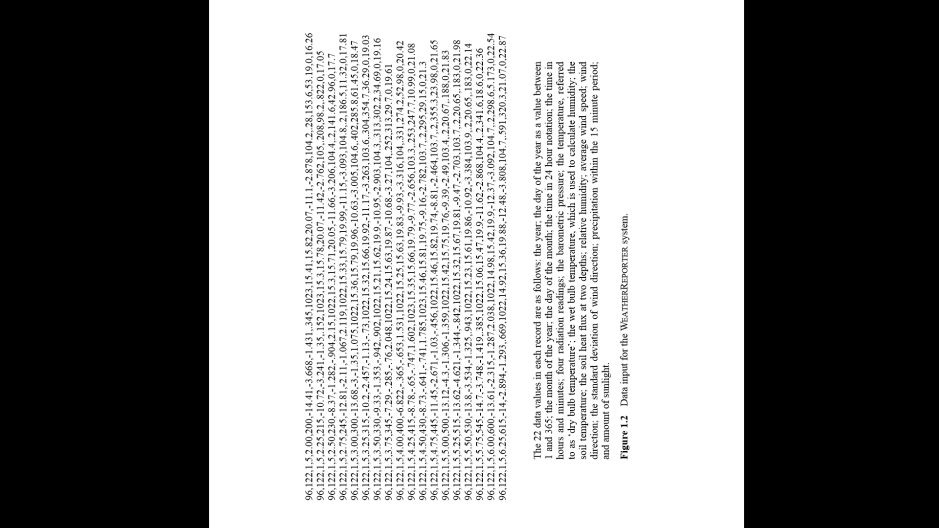
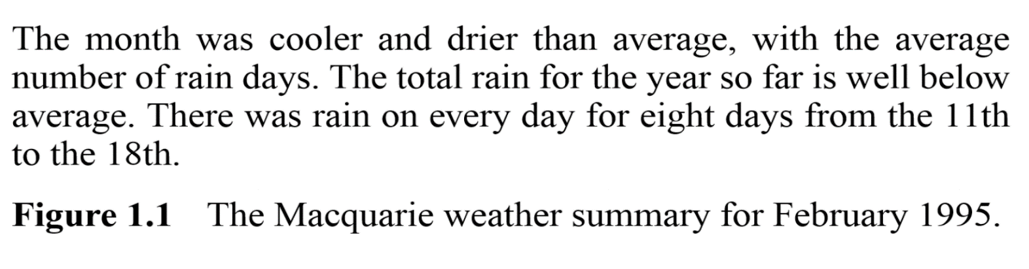
WEATHER REPORTER
(AN ARTICULATE MACHINE BY ARRIA NLG)
Figure 1.2: Generated Text
( )
Source: Building Natural Language Generation Systems by Dale and Reiter
Figure 1.1: Data Source

Slide 6
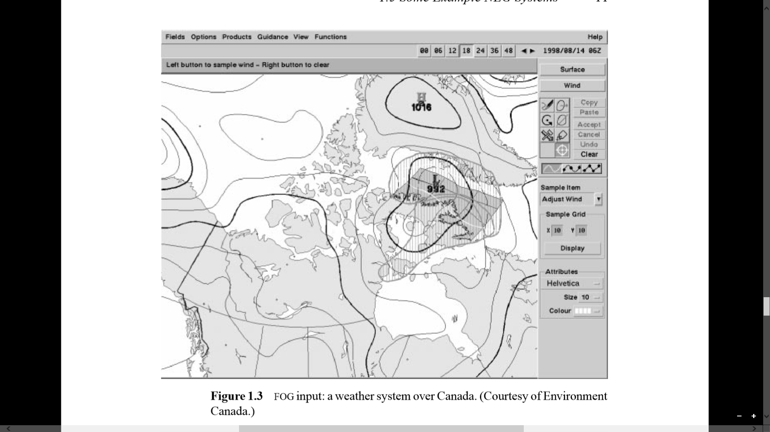
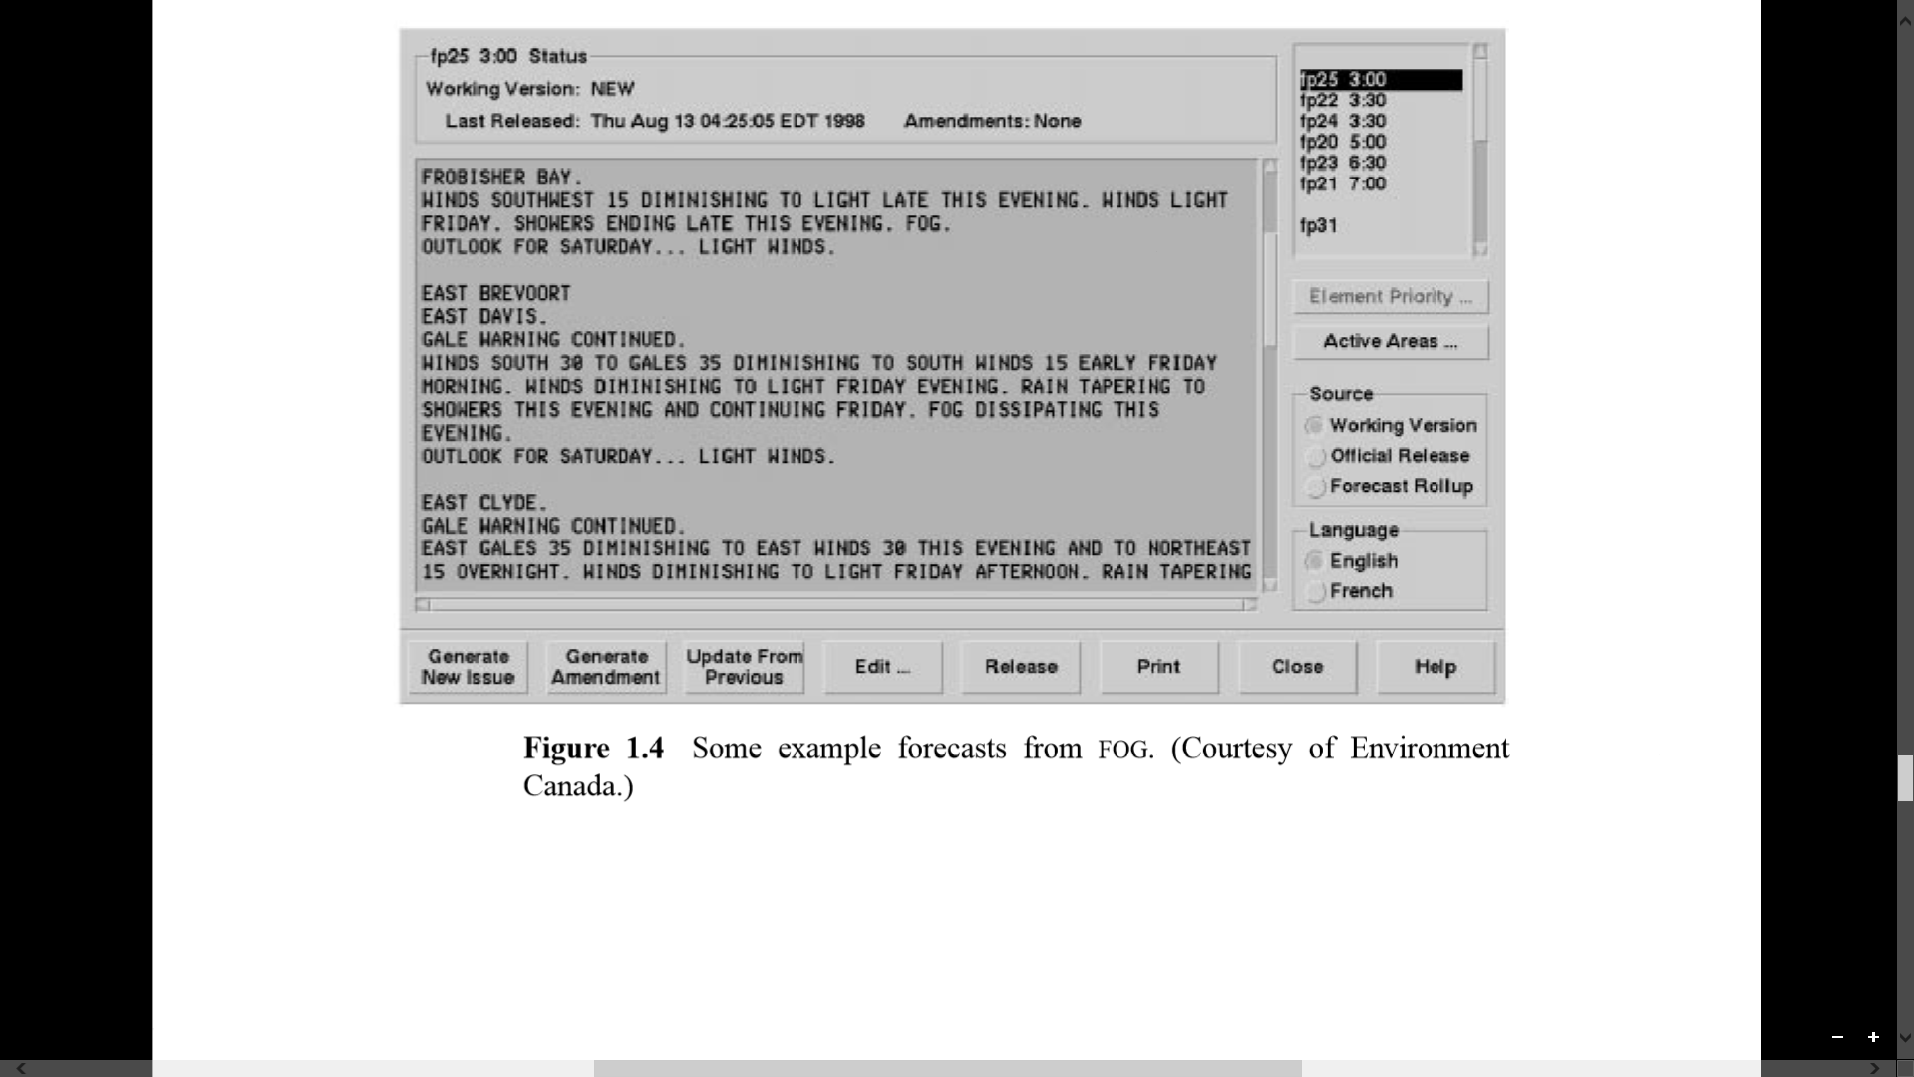
FOG SYSTEM
(Goldberg et al 1994)
Source: Building Natural Language Generation Systems by Dale and Reiter

Slide 7
EXPERTISED KNOWLEDGE CAPTURE
EMBODIMENT OF KNOWLEDGE
AND SKILL SETS

Slide 8
DOMAIN

Slide 9
DYNAMIC,
SPATIAL,
TEMPORAL,
ANALYSED DATA
www.tinyurl.com/project-augment

Slide 10
BIG PICTURE OF ENTIRE PROJECT.
VISUO ANALYSIS DONE THROUGH SOFTWARES
DEVELOPED BY VISUAL COMPUTING
EXPERTS
SAMPLE OF VIDEOS RECORDED
AT VARIOUS LOCATIONS WITH
DIFFERENT MOTION SETS
REGULAR GRAMMAR
BASED NLG ENGINE WHICH TAKES
ANALYSED DYNAMIC SPATIO-TEMPORAL
DATA AS INPUT
HUMAN LIKE NARRATIVE TEXT REPORTS,
TEXT OF ANALYSIS SUMMARY.

Slide 11
PROLOG
More interactive.
Direct logical specifications makes it more easier.
Prolog applications are comparatively smaller to Java due to less complex libraries.
Syntactic constraints are handled early and naturally, ensuring the expressibility of selected concepts.
Order of adding content is flexible, allowing varied sentences without complicated search.
Grammatical knowledge is stated once only, inside the generator.
Enables efficient descriptions that refer implicitly to parameters from the context.
Enables efficient descriptions that exploit the hearer's ability to recognize inferential links to material elsewhere in the sentence.

Slide 12
HOW DOES THE
SYSTEM WORKS?

Slide 13
TEXT PLANNING -
INTERACTION DESCRIPTION SCHEMA
Properties of the subject in the interaction,
Name of the subject in the interaction,
Analysis of the motion identified,
Name of motion identified,
Object List
5.1 [Relation between the two consecutive results,
5.2 Properties of the object,
5.3 Name of the object],
6. Expected Tense of Action.
generateSentence( [[], 'Barbara', [], focus, on, 'Drinking Water', sign, at, corridor, end], Sentence).

Slide 14
FROM WHERE DOES
THESE INPUT VALUES
COME FROM?

Slide 15
LINGUISTIC REALISATION
MORPHOLOGICAL
REALIZATION
SYNTACTIC
REALIZATION
PART OF SPEECH IDENTIFICATION
LEXICON
1. Properties of the subject in the
interaction - Adjective
2. Name of the subject in the
interaction - Noun
3. Analysis of the motion identified - Adverb
4. Name of motion identified - Main Verb
5. ObjectList
[Relation between the two
consecutive results - Preposition
Properties of the object- Adjective
Name of the object] - Noun
6. Expected Tense of Action - Tense
Prototype of structure of a noun
in the list:
noun(barbara, living).
noun(sign, definiteNonLiving).
noun(door, indefiniteNonLiving).
Examples of verbs:
verb(walk, walks, walked, walking).

Slide 16
LINGUISTIC REALISATION
MORPHOLOGICAL
REALIZATION
SYNTACTIC
REALIZATION
For Simple Sentences:
<Sentence> ::== <NounPhrase> <VerbPhrase>
<NounPhrase> :== [<det>] <adjective*> <Noun>
<VerbPhrase> :== [<auxillaryVerb>] <adverb*><mainVerb> [<ObjectPhrase>]
<ObjectPhrase> :== [<preposition>] <nounPhrase>
Complex statement-
<Sentence> ::== <S> ('because')|('therefore')|('so')|('after') <S>
<S> ::== <NounPhrase> <VerbPhrase>
<NounPhrase> :== [<det>] <adjective*> <Noun>
<VerbPhrase> :== [<auxillaryVerb>] <adverb*><mainVerb> [<ObjectPhrase>]
<ObjectPhrase> :== [<preposition>] <nounPhrase>
Compound statement-
<CompleteSentence> :== <``While''> <S> <<','> <S>+> [<'and'> <S>]
<S> :== <NounPhrase> <VerbPhrase>
<NounPhrase> :== [<det>] <adjective*> <Noun>
<VerbPhrase> :== <auxillaryVerb> <adverb*><mainVerb> <OP>
<ObjectPhrase> :== <preposition> <nounPhrase>

Slide 17
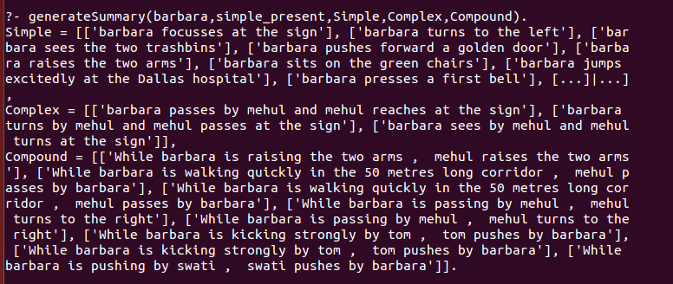
DOMAIN DESCRIPTION DATA SAMPLES FOR BARBARA
OUTPUT SAMPLE NARRATIVE TEXT FOR BARBARA
FORMAT USED IS –
objectInformation(Subject,
SpatialRelation,
Object)
EXAMPLE:
objectSpatialRelation(Subject,by,Person) :- subject(Subject), person(Person).
objectSpatialRelation(Subject,at,
'drinking-water-sign'):-subject(Subject).
objectInformation(Subject,
PropertiesOfObject,
Object)
EXAMPLE:
objectInformation('50m long',corridor).
objectInformation(blue, elevators).
Barbara is walking in a 50m long corridor.
Barbara sees the ‘Drinking-Water’ sign at the corridor end.
While Barbara is walking in the corridor, Mehul passes Barbara.
Barbara turns left at the end of the corridor.
Barbara reaches the blue elevators.
Snapshot of Generated Summary of Barbara

Slide 18
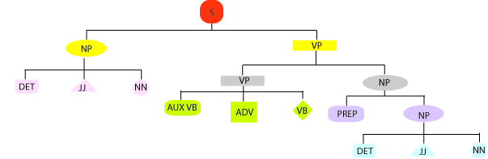
SAMPLE SYNTAX TREE
LINEARIZATION
TEXT GENERATION
[] [] Barbara was [] walking in the 50m long corridor.
[] [] Barbara [] [] sees [] the ‘DrinkingWater’ sign.

Slide 19
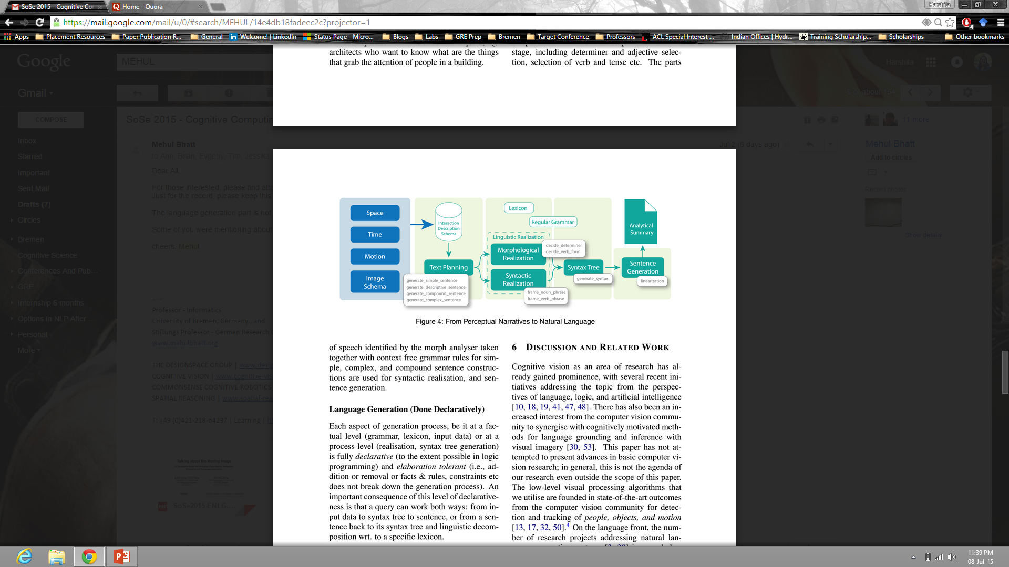
ARCHITECTURE DIAGRAM OF NLG ENGINE
Source: Building Natural Language Generation Systems
Designed By: Jakob Suchan.

Slide 20
THE ROBUSTNESS OF THE DECLARATIVE BUILT STRUCTURE OF NLG ENGINE
?- grammar([ little, Barbara, quickly, focus, on, drinking-water, sign, at, corridor, end, present_continuous],
[[[[]| little ]| Barbara ], [[[[[ is ]| focusing ]| quickly ], on ], [ OBJECT_DETAILS , LOCATION_DETAILS]]]).
OBJECT_DETAILS = [at, [[[the]|corridor]|end]],
LOCATION_DETAILS = [[[the]|drinking-water]|sign]

Slide 21
IMPORTANT FEATURES OF THIS NLG ENGINE:
BUILT IN PROLOG – DECLARATIVE, LOGICAL PROGRAMMING.
SCALABLE.
REPLICABLE.
SAME DATA/ FASTER REPORT GENERATION THAN HUMANS.
NO HUMAN INTERVENTION INVOLVED.

Slide 22
EMPERICAL TEST OF NLG ENGINE:
Manually built dynamic spatio-temporal analysed data corpus.
Value of corpus: 25 subjects,
500 interactions,
53 spatio-temporal domain based facts.
Conduction of Test:
Generation time of 25 summaries was noted on two basis-
Different tenses
Type of clause structure of generated sentences for each summary(simple, complex, compound)
Result:
An average of 20 interactions
An average 26.2 sentences per summary
17.6 tokens as the average length of each sentence

Slide 23
Average time taken for generation of sentences
Different clause structures on a scale of 100 generated sentences
Time for :-
one simple sentence being approximately 0.52/msec,
one compound sentence being 1.23/msec
one complex sentence being 1.32msec

Slide 24
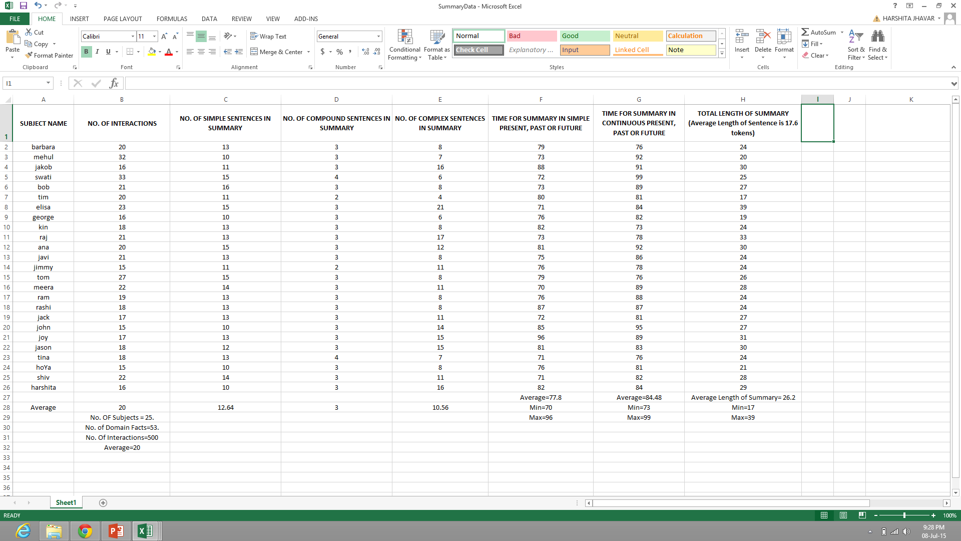

Slide 25
System took average time of :-
77.8msec for generating summaries in simple
present/past/future
84.48msec continuous present/past/future
respectively for all subjects.

Slide 26
CONCLUSION
Highly scalable.
Can render paragraphs in less than a second.
Same data can produce multiple reports according to requirements of different users.

Slide 27
FUTURE WORK
Coming up with ‘Discourse Model’ for language generation in the same domain.
Sentences with Pronouns, Numbers (Singular/Plural).
Forming Interrogative, Reflexive, Exclamatory, Negation.
Increase the features of Grammar Involved.
Building Natural Language Based, Declaratively built, Question-Answering System.

Slide 28
REFERENCES
D. Roy and E. Reiter. 2005. Connecting language to the world. Artificial Intelligence, 167:1–12.
M Mitchell, K van Deemter, E Reiter (2010). Natural Reference to Objects in a Visual Domain. Proceedings of INLG-2010, pages 95-104
Yuan ren, Kees van Deemter, Jeff Z. Pan. Charting the potential of description logic for the generation of referring expressions. Proceedings of INLG-2010.
Barbara Di Eugenio, Michael Glass, Michael J. Trolio, Susan Haller. Simple Natural Language Generation and Intelligent Tutoring Systems. Proceedings of the 2005 conference on Artificial Intelligence in Education: Supporting Learning through Intelligent and Socially Informed Technology.
Albert Gatt and Ehud Reiter, 2009, SimpleNLG: A realisation engine for practical applications, ENLG '09: Proceedings of the 12th European Workshop on Natural Language Generation
R Kutlak, C Mellish, K Van Deemter, 2013, Content Selection Challenge-University of Aberdeen Entry, ENLG '13 Proceedings of the 14th European Workshop on Natural Language Generation
Jette Viethen, Margaret Mitchell, Emiel Krahmer 2013, Graphs and Spatial Relations in the Generation of Referring Expressions, ENLG '13 Proceedings of the 14th European Workshop on Natural Language Generation.

Slide 29
FURTHER MORE TO PRESENT……
BACHELOR MAJOR PROJECT WORK | EXTRA CURRICULAR ACTIVITIES AT BREMEN
SOME MEMORABLE EXPERIENCES | ACHIEVEMENTS

Slide 30
EXTRA CURRICULAR ACTIVITIES AT BREMEN
ATTENDED SEMINAR SESSIONS BY PROFESSOR MEHUL BHATT AT COGNITIVE SPACE DESIGN LAB FROM APRIL-JUNE 2015.
JOINED Win-Chung SELF DEFENCE CLASSES FOR WOMEN AT UNI-BREMEN.
ATTENDED INTERNATIONAL BREAKFAST AT UNI-BREMEN.
ATTENDED PROJECT DAY AT UNIVERSITY OF BREMEN.
ATTENDED SEMINAR ON HOW TO PLAN YOUR PHD AT UNI-BREMEN.
WENT FOR A VISIT TO CONCENTRATION CAMPS AT BERGEN-BELSON ORGANISED BY UNIVERSITY OF BREMEN, GERMANY.

Slide 31
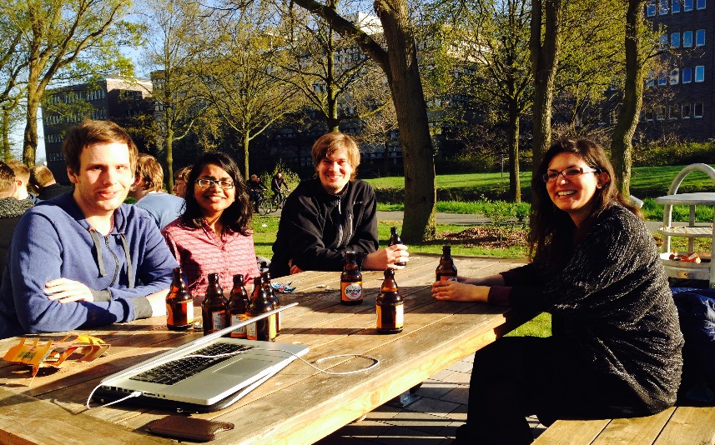
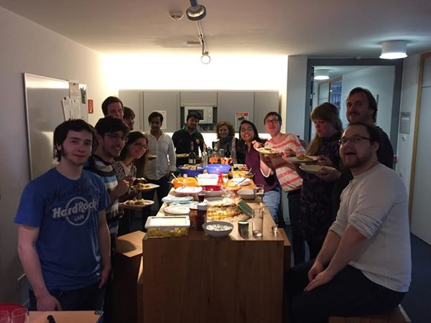
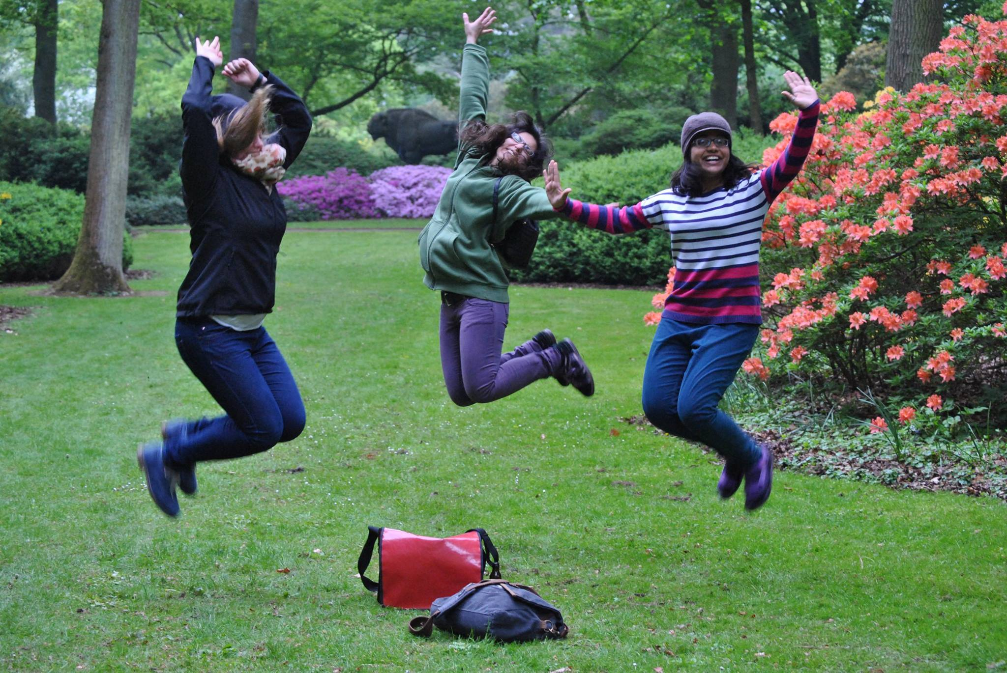
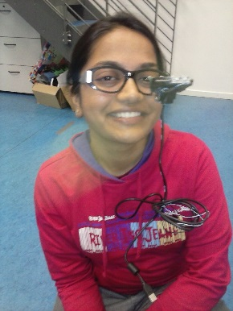
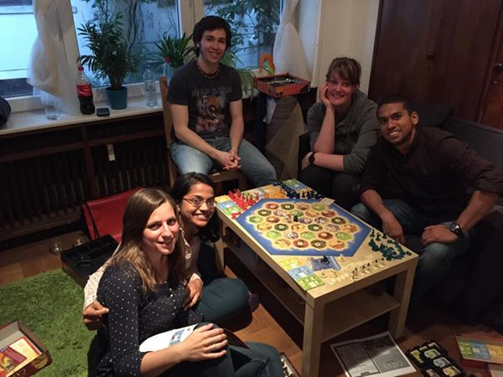
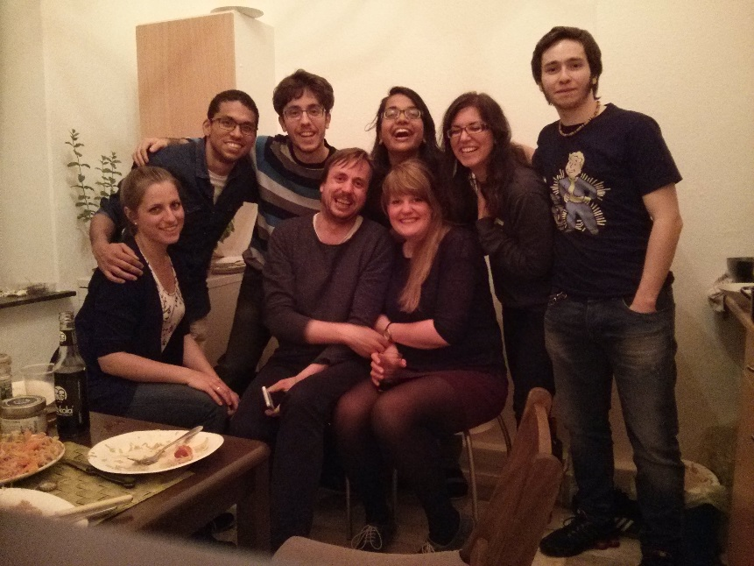
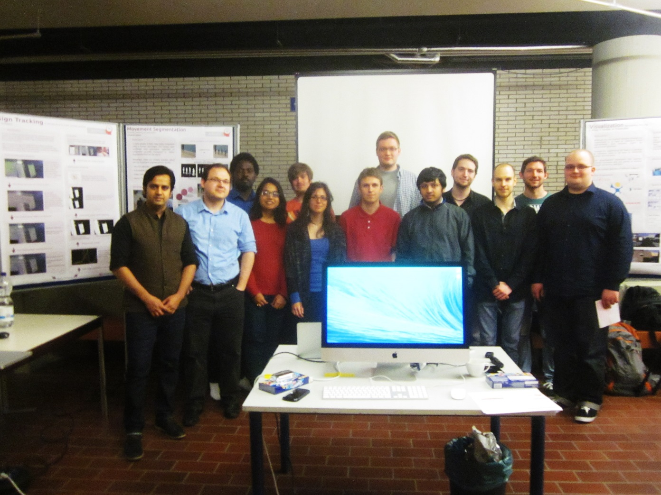
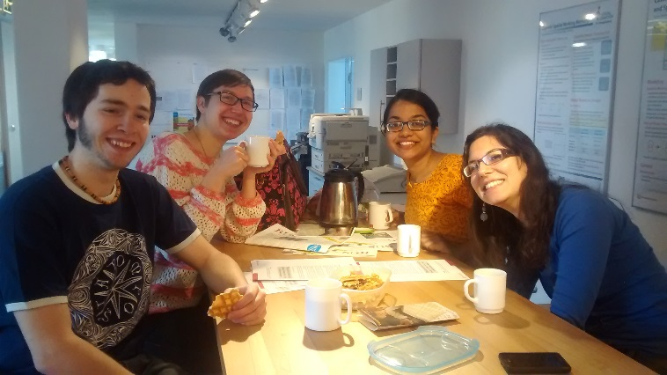
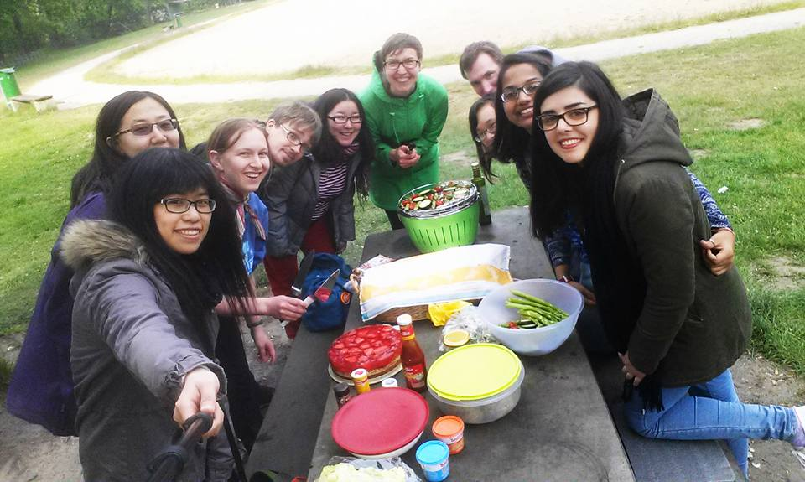
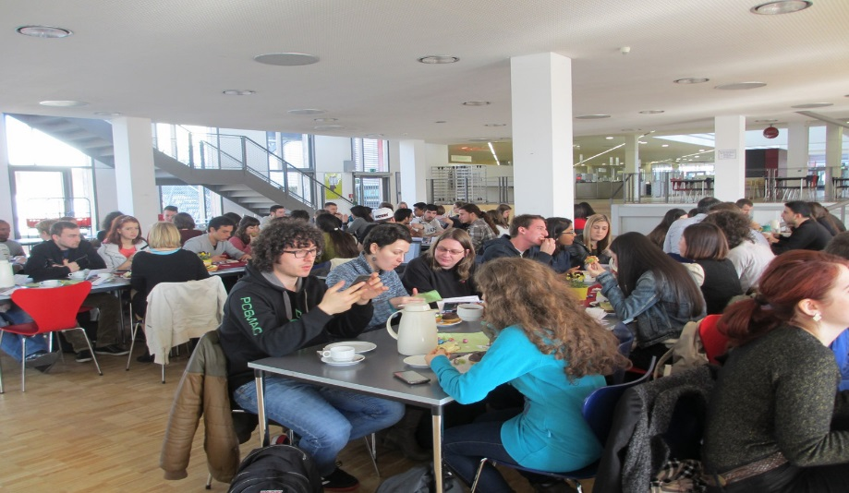
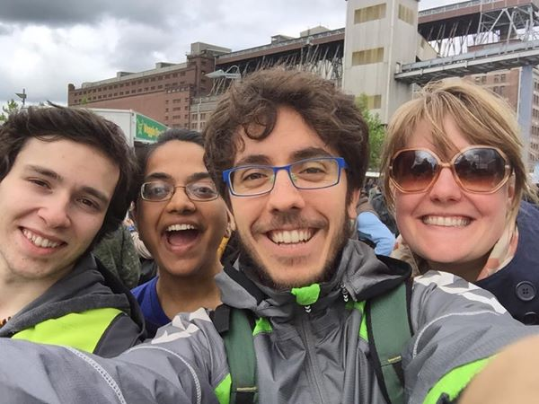
SOME AMAZING MEMORIES

Slide 32
ACHIEVEMENTS
JOINING AS A RESEARCHER UNDER Dr. MEHUL BHATT FROM
SEPTEMBER 2015 TO MAY 2016.
2. CONTRIBUTED INTO A PAPER OF JAKOB SUCHAN AND MEHUL BHATT,
SUBMITTED AT ENLG 2015, RESULTS AWAITED BY JULY 27, 2015.

Slide 33
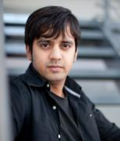

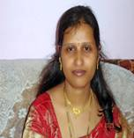
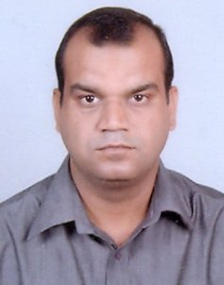
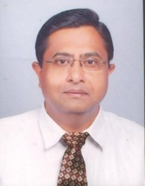

ACKNOWLEDGEMENTS
DR. NILAY
KHARE
(HOD, CSE)
(MANIT BHOPAL)
JAKOB SUCHAN
(PHD STUDENT UNDER Dr. BHATT
AT UNI-BREMEN)
DR. MEHUL BHATT
(External Advisor)
(UNIVERSITY
OF BREMEN)
PROF. SARITHA
KHETHAWAT
(Internal Advisor)
(MANIT BHOPAL)
PROF. MANISH PANDEY
(Student Project Coordinator)
(MANIT BHOPAL)
+ TEAM AUGMENT,
COGNITIVE SPACE DESIGN SOLUTIONS LAB,
UNI-BREMEN, GERMANY.
+ DUPC COMMITTEE,
DEPARTMENT OF COMPUTER SCIENCE AND ENGINEERING,
M.A.N.I.T., BHOPAL, INDIA.
SOURCE: www.manit.ac.in , www.cosy.informatik.uni-bremen.de

Slide 34
THANK YOU
“For a learning enthusiast,
every opportunity matters a lot…… ”

